Slide 1

Text Classification

Slide 2

Problem Statement
Job seekers are increasingly being tricked and deceived by false job postings, risking their safety, security, and well-being. Solutions that can protect innocent job searchers are obviously needed especially when layoffs and a recession cause an increase in the number of people looking for work. Receiving telegram messages about a job opportunity that appears to be from a legitimate recruiter is an example of a problem that is widespread in Singapore or other areas.
Introduction
In this project, we will make use of the (EMSCAD) dataset. The Employment Scam Aegean Dataset (EMSCAD) is a freely accessible dataset of 17,880 real-world job advertisements that seeks to give a comprehensive picture of the Employment Scam issue and identify the features that are most useful in determining the sort of fraudulent job offers.

Slide 3
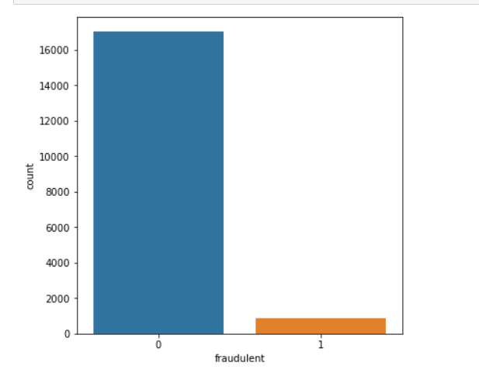
Data Exploration
Data Exploration
Before moving on to the stage of model building, exploratory data analysis (EDA) is required after data collection. This process of data exploration includes finding insights, underlying hidden patterns and imbalanced data.
Insights
Bar chart was utilized to see the comparison between legitimate & fraudulent postings. This also indicates the data is highly imbalanced due to the vast difference of the two job postings.
EDA was also used to find various insights on what are the highly correlated attributes that contributes to fraudulent postings

Slide 4
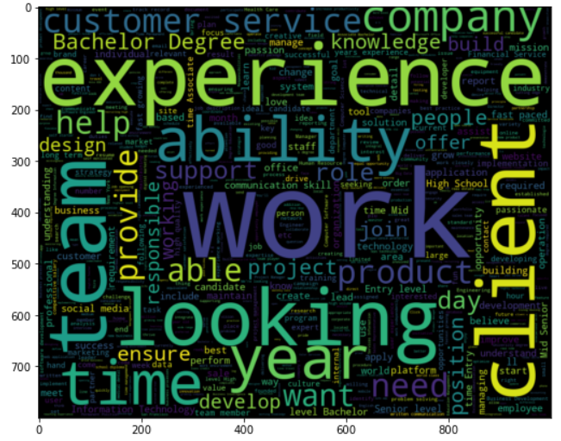
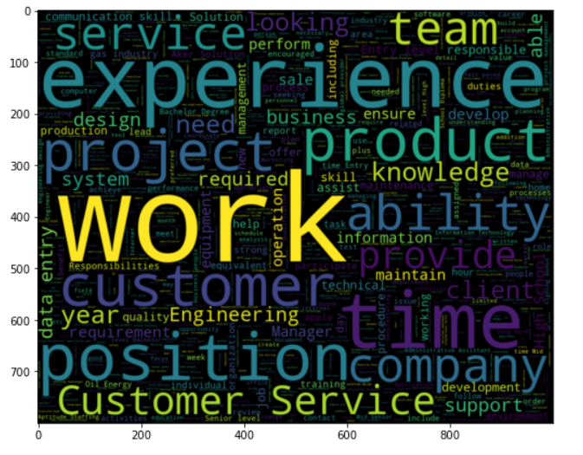
Textual Data Analysis
Data Pre-Processing
After completing EDA and knowing about the correlated features. All the relevant features were combined into a data frame for textual data analysis, while the irrelevant features were removed.
Insights
The frequency of word tokens observed in non-fraudulent and fraudulent job postings was represented as a word cloud.
As observed in the word cloud, the most often used words were found in attributes like "title," "company profile," "description," "requirements," and "benefits," bringing us to the feature selection step.

Slide 5
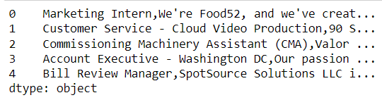
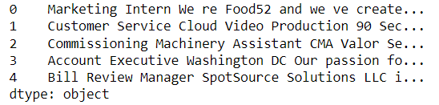
Data Pre-Processing
Data Pre-Processing
NLTK (Natural language toolkit) will be a level library used for removing stopwords, deleting punctuation such.,! $() *% @ &, and other activities involving natural language.
Techniques
Tokenization will be used to divide a paragraph or piece of text into tokens, which can be characters or subwords. This is important because the meaning of the text can be easily understood by analyzing the words in the text. Punctuation was removed from the text & combined into a single sentence.
Once done, the data set will be split into 70% training & 30% testing for model classification
Before Pre-Processing
After Pre-Processing

Slide 6
Model Algorithms
Baseline Models
Logistic Regression, Random Forest Classifier, K-Nearest Neighbor & Decision Tree Classifier were use as the baseline models for results.
Room For Improvements
There is room for improvement in terms of raising accuracy score by utilizing grid search for Logistic Regression, Random Forest Classifier & Decision Tree Classifier. Grid-search would be used to determine the ideal model hyperparameters that result in the more 'accurate' predictions.
K-fold cross validation may be used to tune the KNN model by determining the error rate for a portion of the training set. Cross-validation is a technique for evaluating predictive models that divides the original sample into a training set for training the model and a test set for evaluating it, which reduces overfitting.

Slide 7
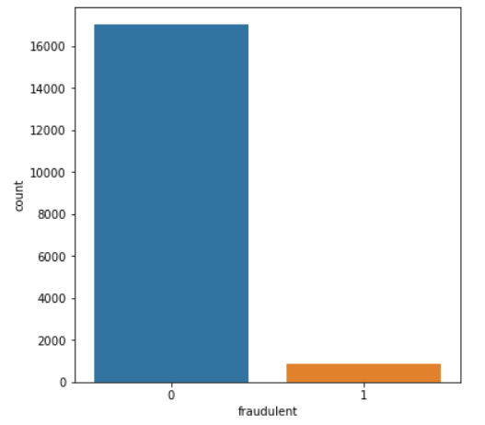
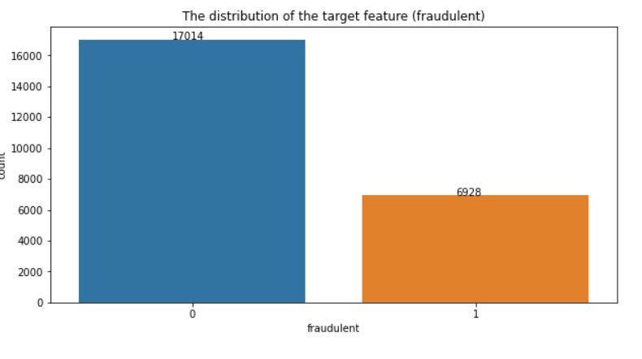
Oversampling Of Data
Oversampling
Oversampling was a technique used to balance the distribution of classes in a dataset, which was significantly imbalanced in this project.
Fraud data is oversampled in order to balance the dataset's class distribution. The final dataset will have a more equal distribution of fraud and non-fraud instances after repeating the fraud data seven times.
Before Oversampling
After Oversampling

Slide 8
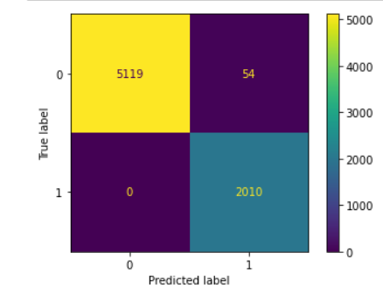
Oversampling Removed
Despite oversampling the data, the model accuracy increased, and the confusion matrix showed 0 false negatives, which is inconsistent.
This might indicate that Overfitting may occur. If the model is sufficiently sophisticated, it may memorize the oversampled data and fail to generalize effectively to new data.
As a result, the oversampling technique was removed as it did not seem to aid in a realistic model accuracy.
LR Model after oversampling

Slide 9
Model Results
Baseline Model Results
Model Results After Tuning
Model | Accuracy% (Train) | Precision (Test) | Recall (Test) | F1-Score (Test)
LR | 98.47% | 0.84 | 0.79 | 0.81
RF | 98.39% | 0.97 | 0.64 | 0.77
KNN | 96.77% | 0.60 | 0.74 | 0.66
DT | 98.07% | 0.77 | 0.78 | 0.78
Model | Accuracy% (Train) | Precision (Test) | Recall (Test) | F1-Score (Test)
LR | 97.41% | 0.90 | 0.77 | 0.83
RF | 98.43% | 0.97 | 0.66 | 0.79
KNN | 96.96% | 0.71 | 0.48 | 0.57
DT | 97.97% | 0.76 | 0.67 | 0.71

Slide 10
Model Comparison
Cross-validation AUC was used to the models to determine the average AUC score achieved from cross- validation, a technique used to assess the performance of machine learning models.
Based on the results, we can conclude that Random Forest, with a 97% accuracy, is statistically the best model in terms of AUC in comparison to the test data.
According to the classification report. Using the word and description, we identify job posting fraud, and recall is chosen as the performance metric that shows true positive rate. The model's recall guarantees that it detects all cases with a positive target. As a result, logistic regression is the best performance due to its high recall score.

Slide 11
Conclusion
On the training data, the Random Forest model with the top five features had the greatest cross-validation AUC score. In terms of AUC, it also beat other models such as KNN and Decision Tree.
On the test data, however, the Logistic Regression model obtained the greatest recall score. According to the results, the models are resistant to the number of features utilized, and a small number of features were chosen to minimize overfitting and make the models easy to train and interpret. The features were chosen based on the quantity of words they included, with the five chosen features having the most words.
Overall, the aim of developing a reliable classification model for identifying fake job adverts using words and descriptions was met with high accuracy.

